Slide 1
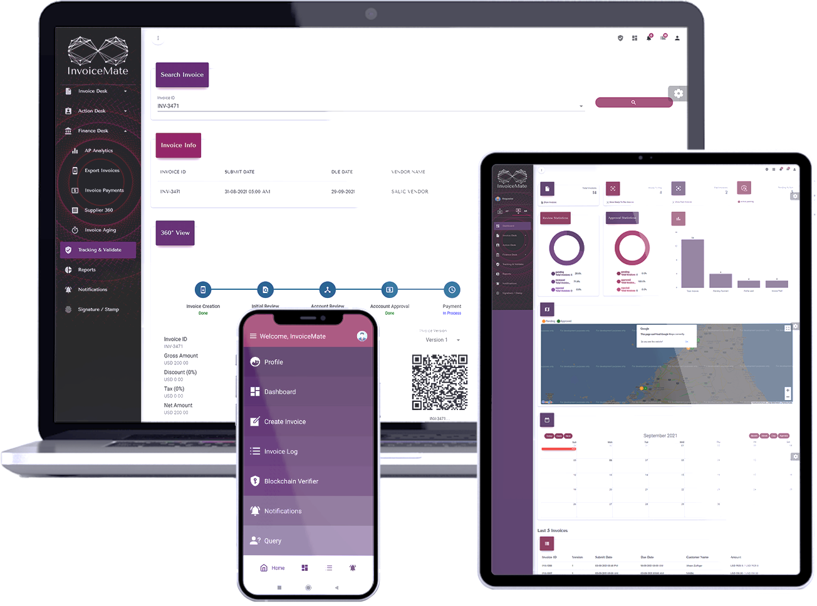
Trusted & Efficient Partner for KYI (Know Your Invoice)

Slide 2
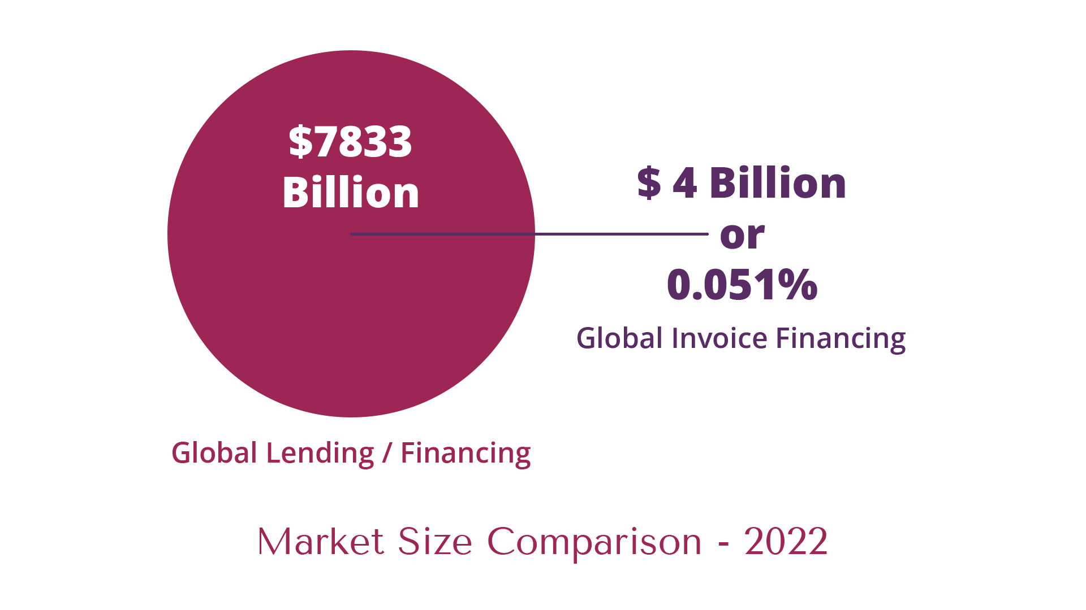
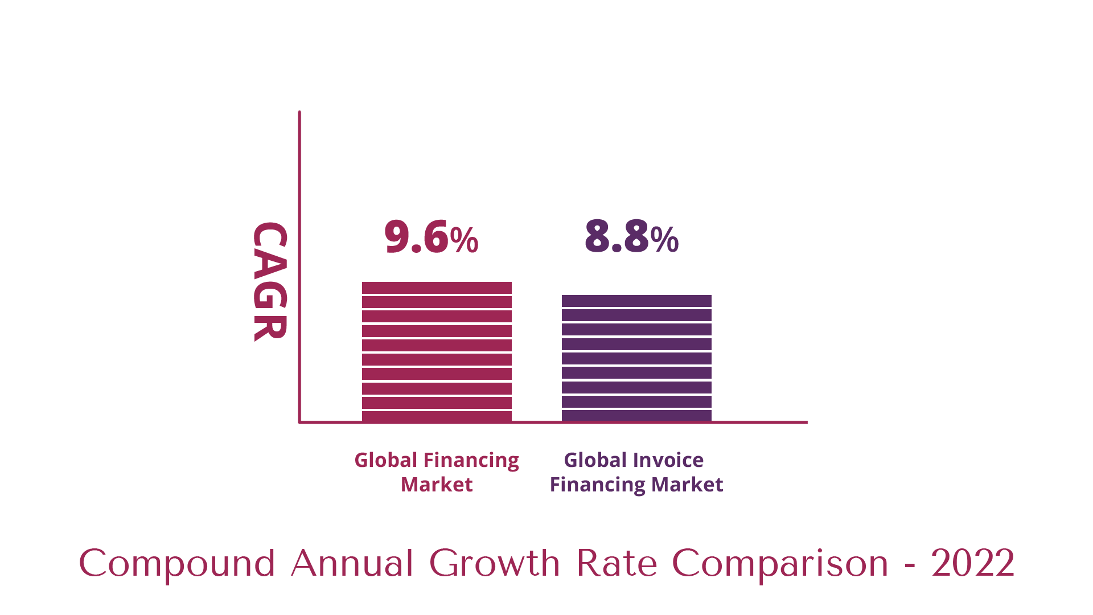
Total Lending/Financing Market Vs. Invoice Financing Market Size

Slide 3
Why Portion of Invoice Financing in Total Financing Market is Negligible

Slide 4
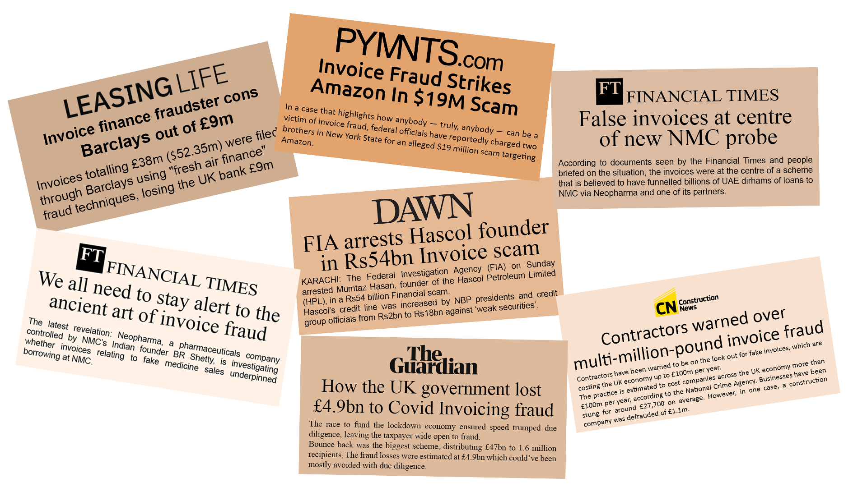
Frauds in Invoice Financing is Global & Regular Phenomena

Slide 5
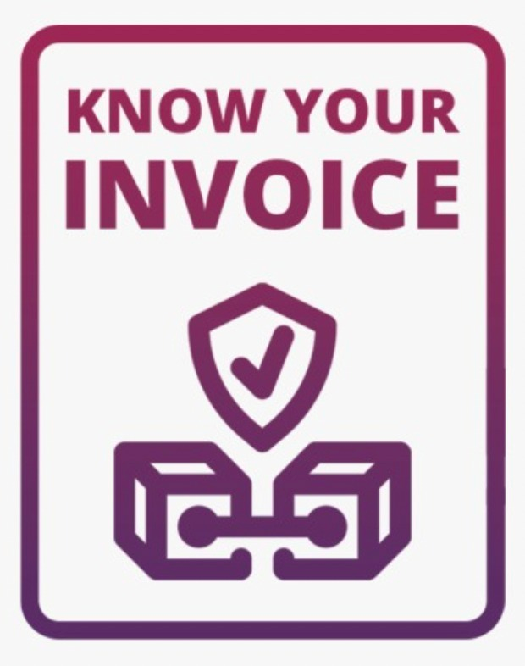
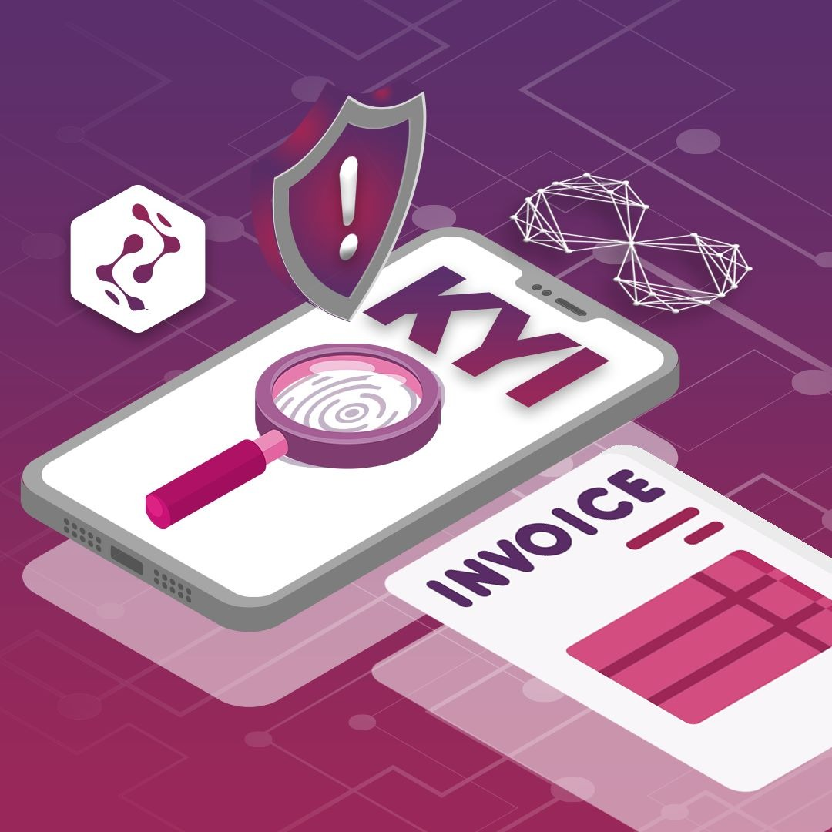
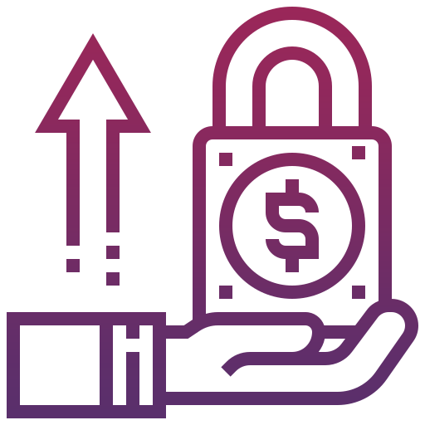
Solution: Banks/Financial Institutions Need KYI for Invoice Financing

Slide 6
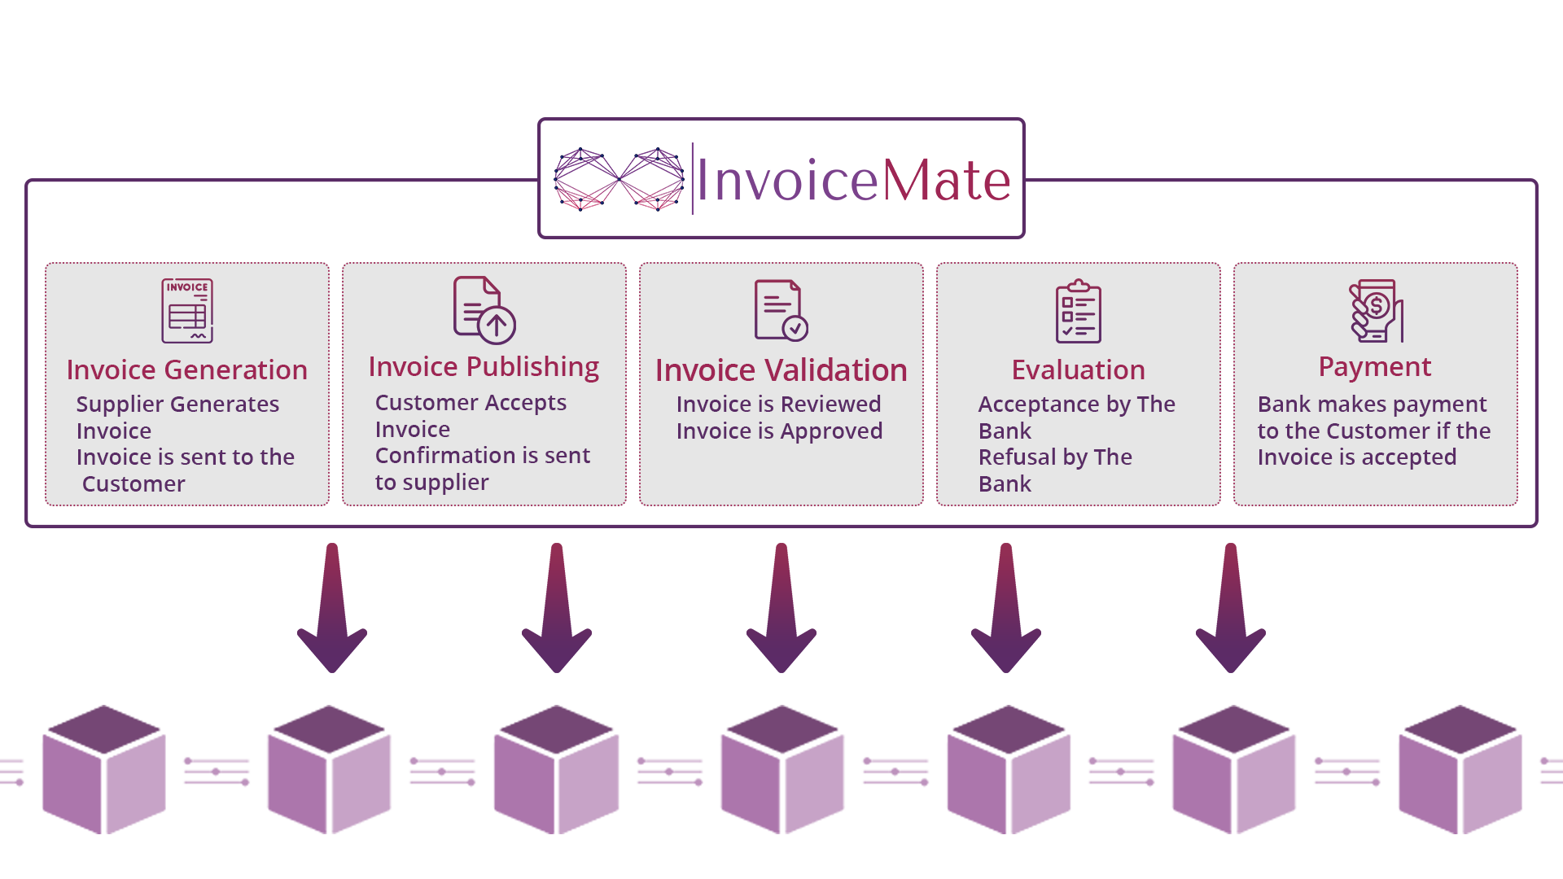
KNOW YOUR INVOICE (KYI)
InvoiceMate using blockchain technology brings unique value preposition of “Know Your Invoice-KYI” to banks/financial institutions for their trusted & efficient invoice financing by easing the due diligence process for invoice.

Slide 7
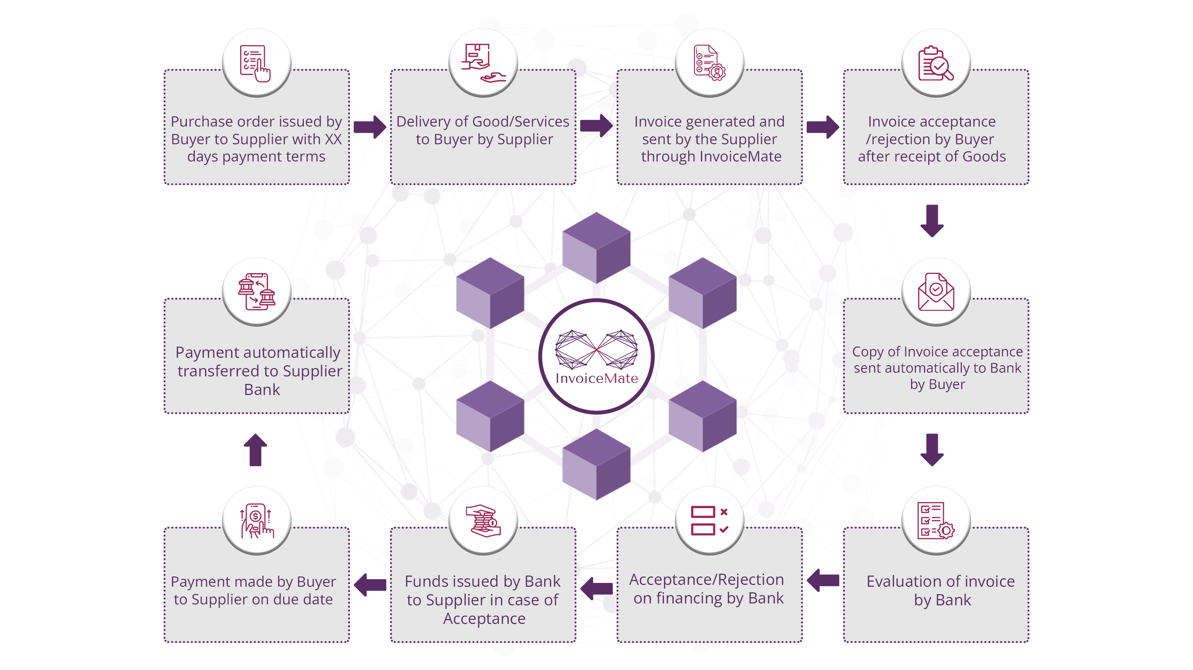
KYI Platform – Entire Journey of Invoice on Blockchain

Slide 8
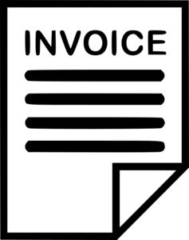
Value Preposition of KYI for Banks/Financial Institutions
Tier 1 Businesses
Tier 1 Vendors
Bank/Financial Institution
Risk Profiling
Invoice Verification
Eligibility Algorithm
Secured & Quick Invoice Financing

Slide 9
Roll Out Framework in Pakistan
Pakistan B2B
Jazz Ecosystem
Payment Channel
Implementation Partner
BaaS Platform

Slide 10
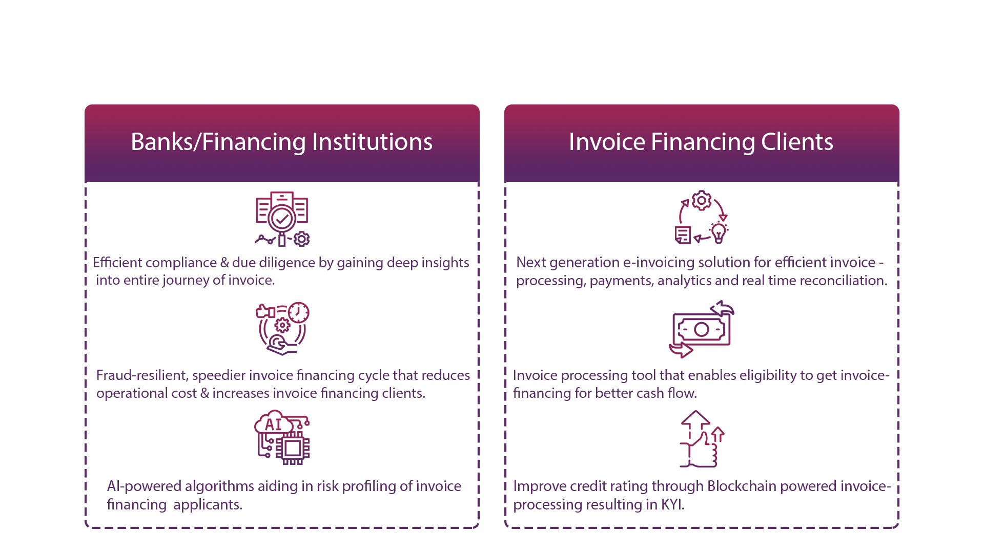
Benefits of KYI with InvoiceMate

Slide 11
InvoiceMate – Enabler for Financial Inclusion

Slide 12
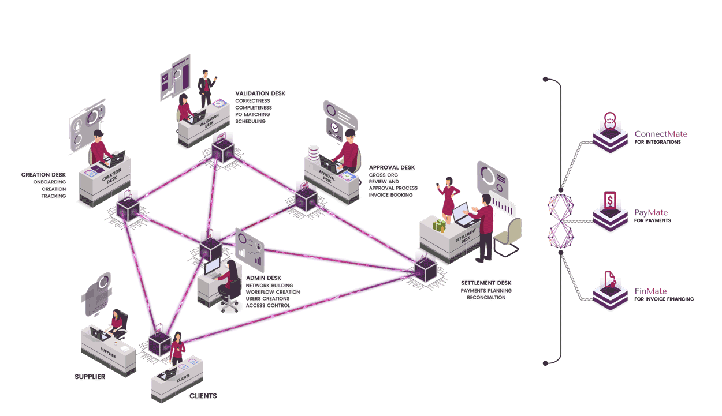
InvoiceMate: Next Generation Invoicing Platform
Notes:
Here is how next gen automation of InvoiceMate is different than automation of legacy ERPs and accounting packages:

Slide 13
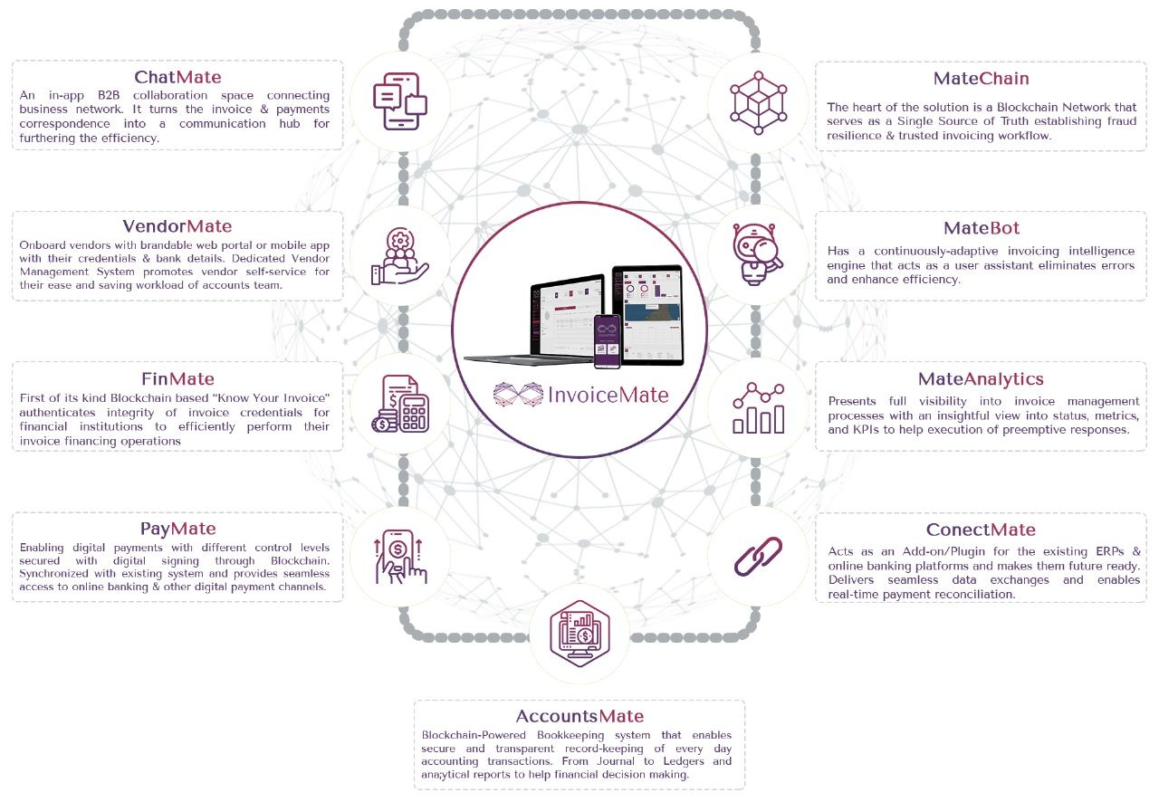
InvoiceMate Differentiators as Invoice Management System

Slide 14
InvoiceMate Pro (Corporate) & InvoiceMate Lite (SMEs & Freelancers)
 | Features | Pro | Lite | Details
1 | Supplier Onboarding | ◉ | ◉ | Express Sign Up
2 | Dashboard & Analytics | ◉ | ◉ | Monitor & Track Your Invoices
3 | Invoice Creation / Receiving | ◉ | ◉ | Unlimited Invoices
4 | Invoice Operations | ◉ | ◉
5 | Invoice Me | ◉ | ◉ | Share link of your invoice Mate For invoicing and payments
6 | Create Payment Vouchers | ◉
7 | Create & Issue Digital Cheques | ◉
8 | Batch Payments / Online Payments | ◉ | ◉ | Invoice Based Payments
9 | Customized Workflows | ◉
10 | Supplier Onboarding (AP) | ◉
11 | Customer Onboarding (AR) | ◉
12 | Online Invoice Payments (Fiat + Crypto) | ◉
13 | Customized Notifications & Email Templates | ◉
14 | Customized UI Theme / White-label | ◉
15 | Management Reports | ◉
16 | AI & OCR Feature | ◉
17 | Integrations with core ERP / accounting systems | ◉
18 | Supplier & Customer Ledgers | ◉
19 | Administration Module | ◉

Slide 15
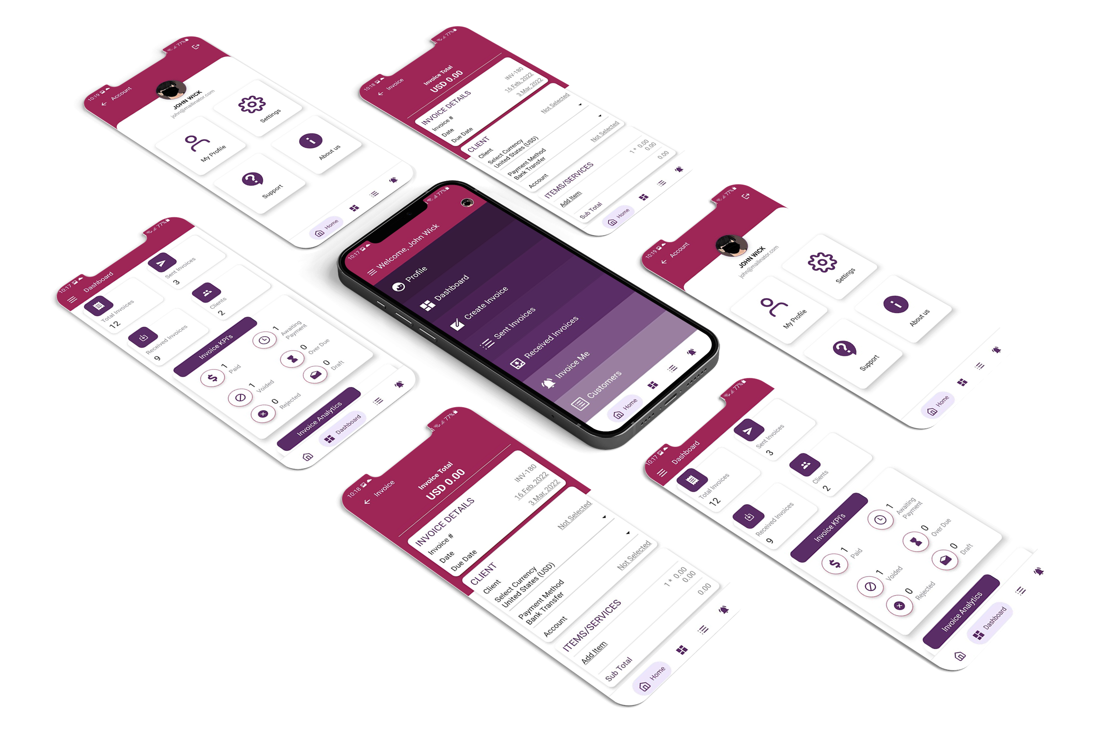
InvoiceMate Lite – Mobile App – Screenshots

Slide 16
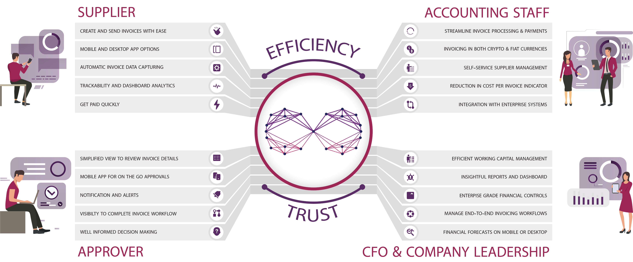
InvoiceMate Case Study of SALIC (Saudi Government Entity)

Slide 17
Early Gov & Corporate Clients

Slide 18
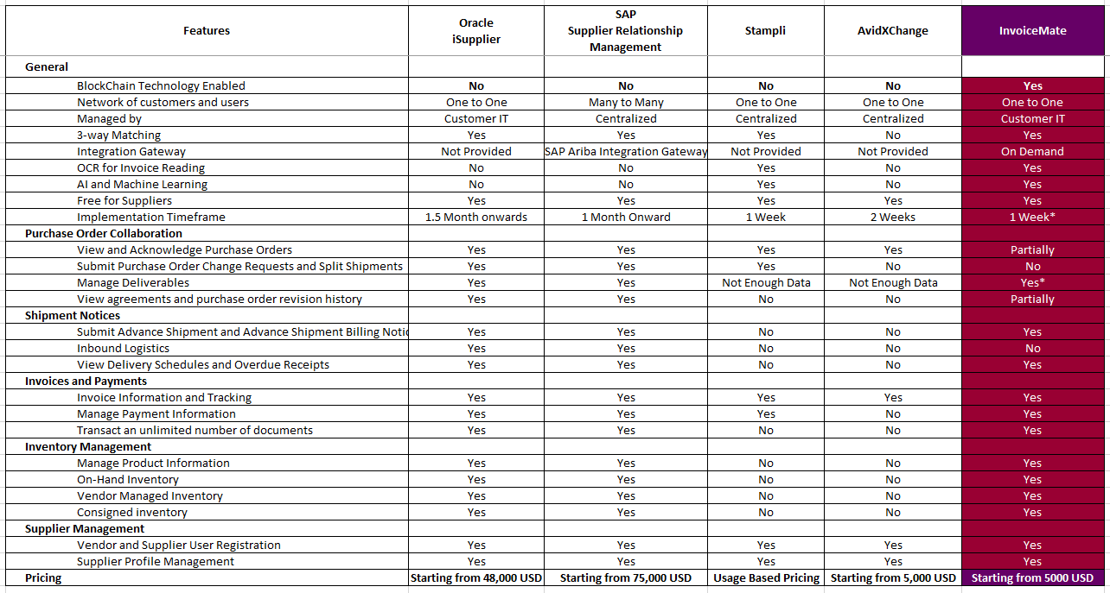
Competitive Advantage – World’s First & Only Invoicing Platform on Blockchain

Slide 19
Institutional Partnership with Jazz in Pakistan
Cloud Integration
Jazz Cash Integration
Implementation Partnership

Slide 20
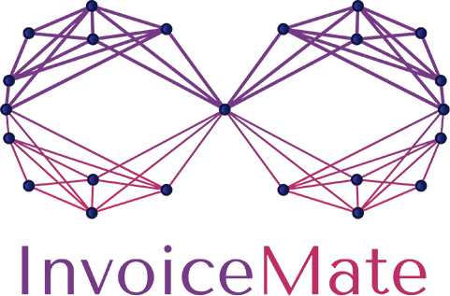
Institutional Partnership with JS Bank & Zindigi
Integration as Payment Channel in InvoiceMate | Collaboration for Trusted Invoice Financing | Integration of InvoiceMate as Digital Payment System

Slide 21
Institutional Partnership with SILK Bank in Pakistan
Ordinance Compliance
Optimum CX
Enhanced Adoption
Data Analytics
No Duplication of Work
Clearance Load Management

Slide 22
Institutional Partnership with KPK Government Entities
Islamic Invoice Financing for KPK Government Vendors

Slide 23
InvoiceMate: First Enterprise Metaverse Application

Slide 24
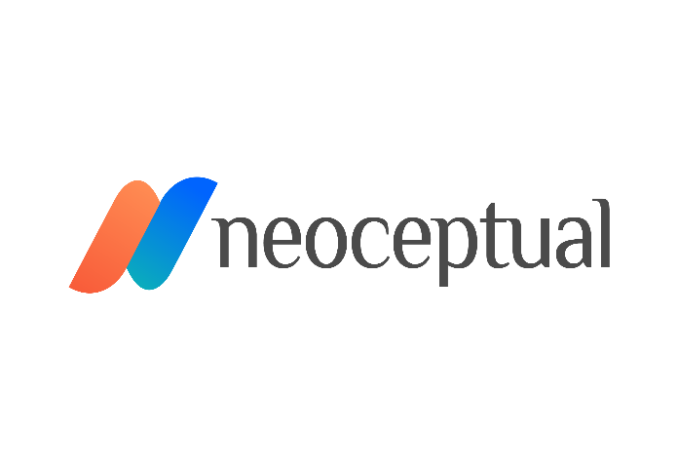
InvoiceMate Team & Strategic Partners
Muhammad Salman Anjum
Usman Salahuddin
Rafael Schultz
Zeeshan Abid
Saeed Al Hebsi
Kevin Murcko
Muhammad Irfan
Nahed Chbak
Vasilisa Marinchuk

Slide 25
Trusted & Efficient Partner for KYI (Know Your Invoice)
mate@invoicemate.net
+971 52 9147510
618, Fairmont Hotel, Dubai, UAE
invoicemate.net
InvoiceMate is Powered by

